Slide 1

Basic Image Processing Operations

Slide 2
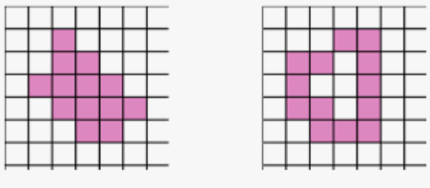
Pixel and Connectivity Concepts

Slide 3
Pixel and Pixel Grid
Pixel
The smallest unit of a digital image or graphic that can be displayed and edited on a digital display system.
Pixels are the building blocks of a digital image.
Pixel Grid
A two-dimensional array of pixels that forms the image. Each pixel in the grid has a specific location defined by its row and column coordinates.

Slide 4
Attributes of Pixel
Intensity: The brightness level of a pixel, often represented by a value in grayscale images.
Color: In color images, a pixel's color is represented by a combination of intensities in different color channels (e.g., RGB - Red, Green, Blue).

Slide 5
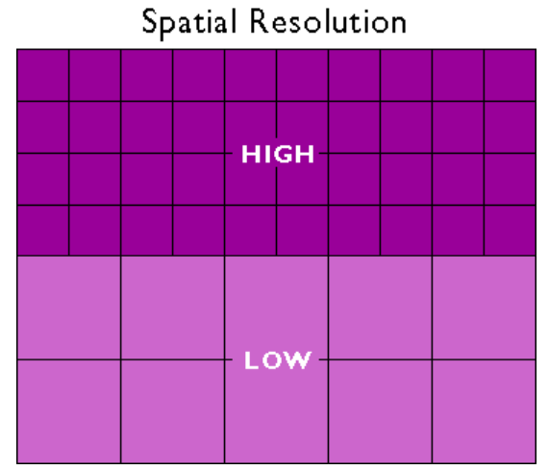
Spatial resolution
The density of pixels in an image, typically measured in pixels per inch (PPI) or dots per inch (DPI).
Images having higher spatial resolution are composed of a greater number of pixels.

Slide 6
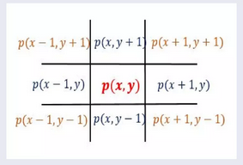
Pixel neighborhood
The neighborhood of a pixel refers to the set of pixels surrounding it.
The concept of pixel neighborhoods is essential for many operations, including filtering, edge detection, and image segmentation.
Pixel p(x,y) has two horizontal and two vertical neighbors.
p(x+1,y) and p(x-1,y) -> Horizontal neighbors
p(x,y+1) and p(x,y-1) -> Vertical neighbors
p(x-1,y+1), p(x-1,y-1), p(x+1,y-1) and p(x+1,y+1) -> Diagonal neighbors

Slide 7
Types of Pixel Neighbourhoods
4-Connected Neighbourhood
8-Connected Neighbourhood

Slide 8
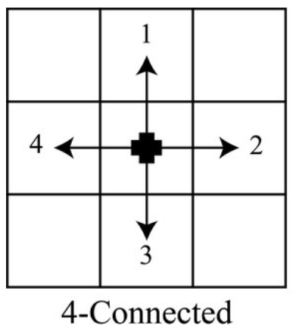
4-Connected Neighbourhood
A pixel's 4-connected neighbourhood consists of the four pixels that are directly adjacent to it horizontally and vertically.
Neighbour Pixels: The pixels located to the left, right, above, and below the central pixel.
Application: Used in simple connectivity and region growing algorithms.

Slide 9
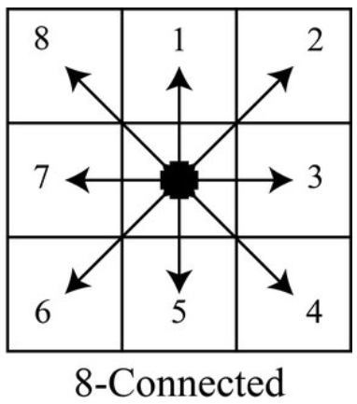
8-Connected Neighbourhood
A pixel's 8-connected neighbourhood includes the four pixels directly adjacent to it, as well as the four pixels diagonally adjacent to it.
Neighbour Pixels: The pixels located to the left, right, above, below, and diagonally adjacent to the central pixel.
Application: Used in more complex connectivity and region growing algorithms where diagonal connections are important.

Slide 10
Applications of Pixel Neighbourhoods
Filtering
Edge detection
Morphological operations
Image segmentation

Slide 11
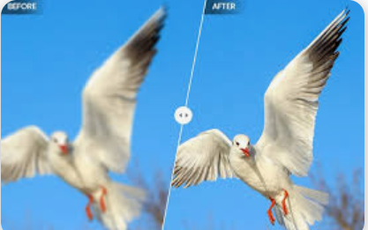
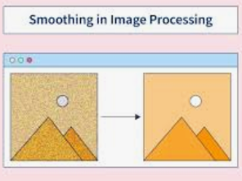
Filtering
Smoothing Filters: Apply operations like averaging or median filtering using the neighborhood pixels to reduce noise.
Sharpening Filters: Enhance edges by considering the differences between the central pixel and its neighbors.
Image sharpening

Slide 12
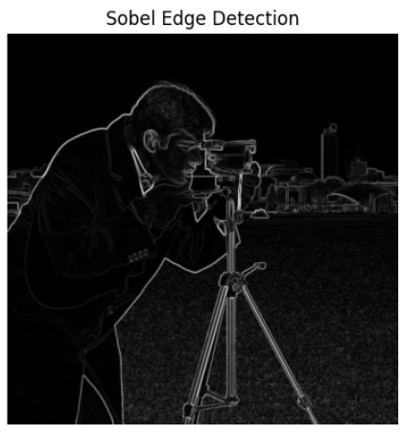
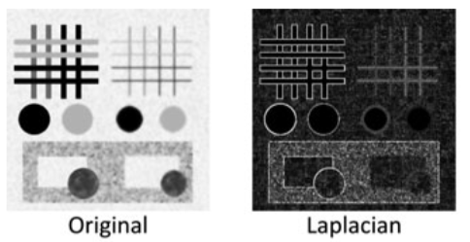
Edge detection
Gradient Operators: Use neighbourhoods to calculate image gradients (e.g., Sobel, Prewitt operators) for detecting edges.
Laplacian Operators: Utilize the neighbourhood to identify regions of rapid intensity change.

Slide 13
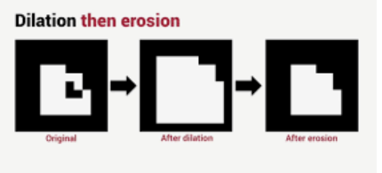
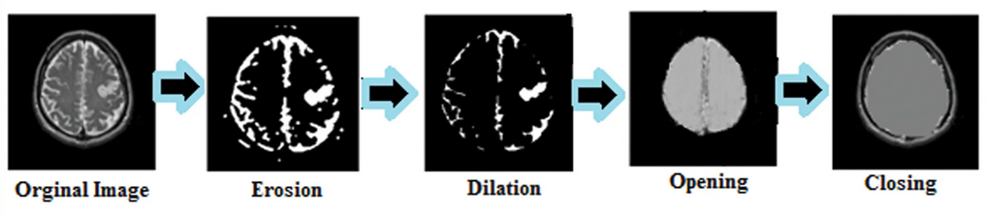
Morphological operations
Dilation and Erosion: Operate on binary images to expand or shrink objects using the pixel neighbourhood.
Opening and Closing: Combine dilation and erosion to remove noise and smoothen object boundaries.

Slide 14
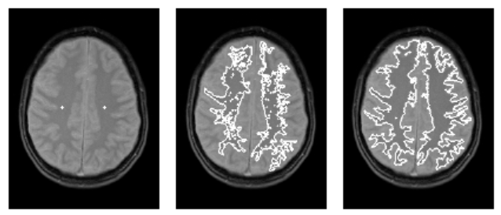
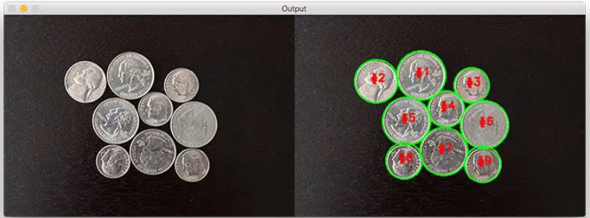
Image segmentation
Region Growing: Expand regions by adding neighbouring pixels that meet certain criteria.
Watershed Algorithm: Use pixel neighbourhoods to identify and separate different regions based on gradients.
Region growing segmentation
Watershed algorithm

Slide 15
Regions
A region in an image is a group of connected pixels with similar properties.
These properties could be related to intensity, color, texture, or any other measurable attribute.
An image may contain several objects and, in turn, each object may contain several regions corresponding to different parts of the object.
For an image to be interpreted accurately, it must be partitioned into regions that correspond to objects or parts of an object.
Regions are fundamental in various image processing tasks, such as segmentation, object recognition, and analysis.

Slide 16
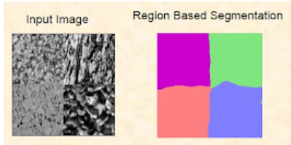
Properties of regions
Homogeneity: All pixels within a region exhibit similar characteristics, such as intensity, color, or texture.
Connectivity: Pixels within a region are connected to each other based on a specified connectivity criterion (e.g., 4-connected, 8-connected).
Boundary: The edge or perimeter that separates one region from another. Boundaries are significant in defining the shape and extent of regions.

Slide 17
Distance measures in image processing
Mathematical formulations used to quantify the similarity or dissimilarity between two points or objects within an image.
These measures are crucial for various image processing tasks such as segmentation, pattern recognition, and morphological operations.
Most commonly used distance measures are :
Euclidean Distance
City Block Distance
Chessboard Distance

Slide 18

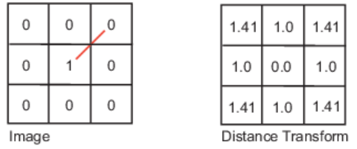
Euclidean Distance
Straight-line distance between two pixels.
Application: Used in edge detection, clustering, and nearest-neighbor classification.
Formula:
Notes:
Only for Spatial Euclidean distance in 2D coordinates which means values in image grid are ignored.

Slide 19
Euclidean Distance Example
The central pixel is the only foreground pixel with value ‘1’.
Note that (x1,y1) = (1,1) since it is central pixel.
Top-left (0,0) :
Top-center(0, 1):
Top-right (0, 2):
Middle-left (1,0):

Slide 20
Euclidean Distance Example (cont.)
Middle-right (1,2):
Bottom-left (2,0):
Bottom-center (2,1):
Bottom-right (2, 2):

Slide 21

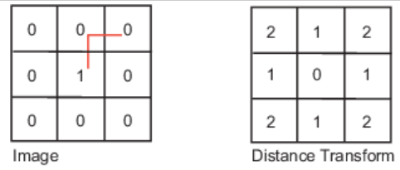
City Block Distance
Measures the path between the pixels based on a 4-connected neighborhood.
Pixels whose edges touch are 1 unit apart; pixels diagonally touching are 2 units apart.
Application : Used in grid-based pathfinding algorithms like A*, and in certain clustering algorithms.
Formula:

Slide 22
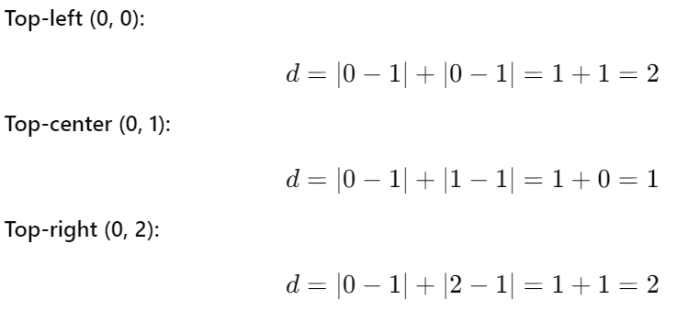
City Block Distance Example
Let's compute the City Block distance for each background pixel:
The central pixel is the only foreground pixel with value ‘1’.
Note that (x1,y1) = (1,1) since it is central pixel.

Slide 23
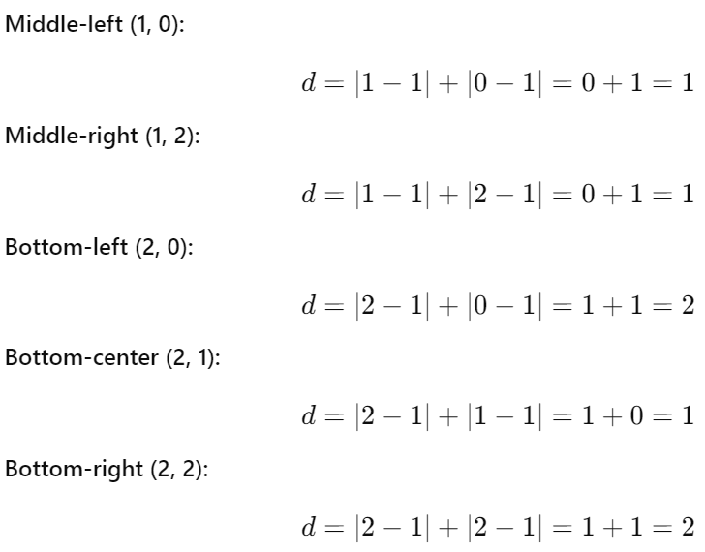
City Block Distance Example (cont.)

Slide 24
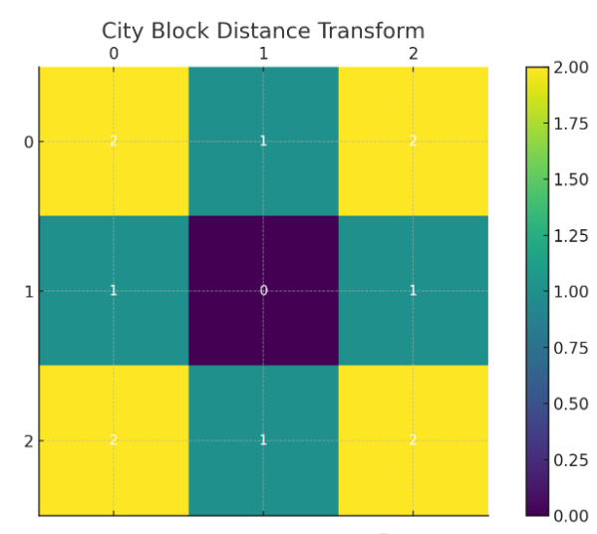
City Block Distance Example (cont.)

Slide 25

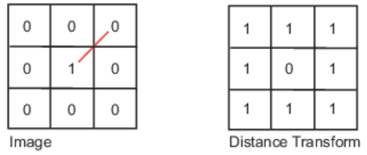
Chessboard Distance
Measures the path between the pixels based on an 8-connected neighborhood.
Pixels whose edges or corners touch are 1 unit apart.
Application : Used in image processing for morphological operations, such as dilation and erosion.
Formula :

Slide 26
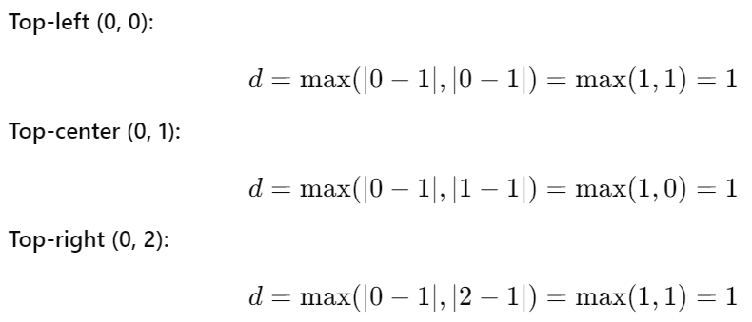
Chessboard Distance Example
Let's compute the Chessboard distance for each background pixel:
The central pixel is the only foreground pixel with value '1'.
Note that (x1,y1) = (1,1) since it is central pixel.

Slide 27
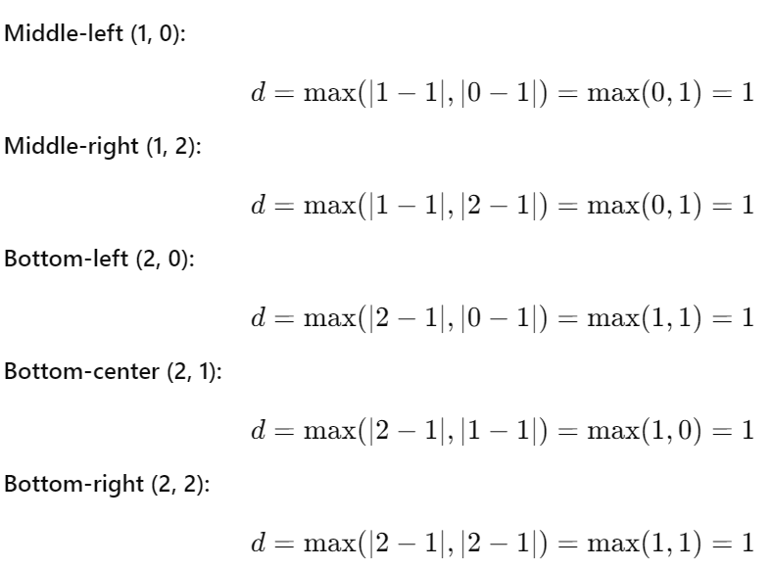
Chessboard Distance Example (cont.)

Slide 28
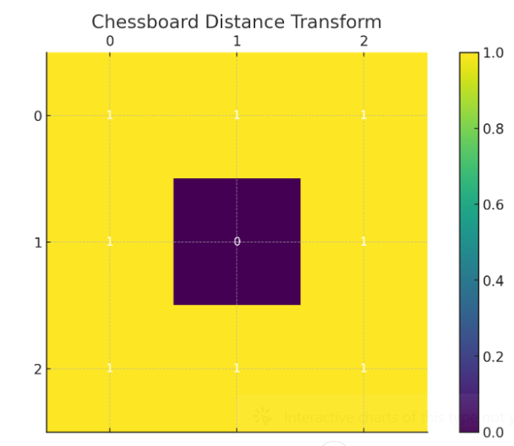
Chessboard Distance Example (cont.)

Slide 29

Image Pre-processing

Slide 30
Image Pre-processing
Image Pre-processing Techniques are the initial steps performed on raw images to improve their quality, remove noise, and make them suitable for higher-level tasks like feature extraction or object detection. The following are the categories of pre-processing techniques:
Image Enhancement - Histogram processing, Spatial domain filtering
Image Restoration - Noise reduction, De-blurring
Geometric Transformations - Image translation, scaling, rotation, shearing

Slide 31
Image processing operations
Arithmetic operations
Logical operations
Geometrical operations
Convolution operations

Slide 32
Arithmetic operations
Involves the manipulation of pixel values using basic arithmetic operators.
These operations are fundamental for tasks such as image enhancement, blending, and morphing.
Common arithmetic operations are :
Image addition
Image subtraction

Slide 33

Image addition
Combines two images by adding the corresponding pixel values.
Formula :
Application :
Image Blending: Used to blend two images together.
Brightness Adjustment: Adding a constant value to an image increases its brightness.

Slide 34
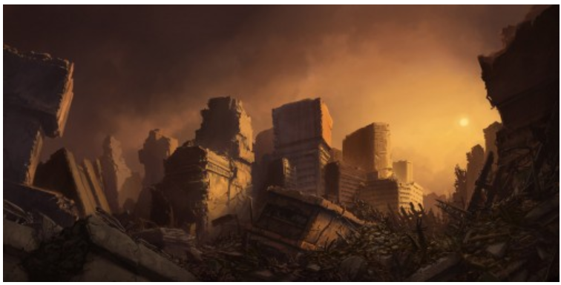
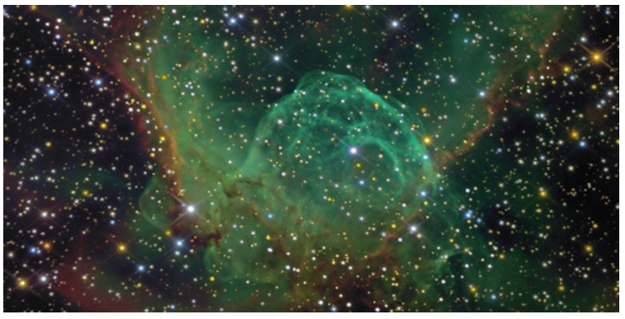
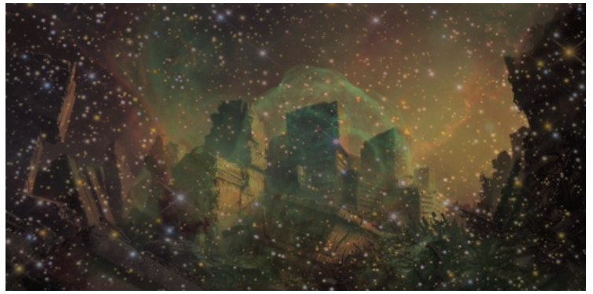
Image addition example

Slide 35
Program for addition of two images (google colab)
import cv2
from google.colab.patches import cv2_imshow
# Load images
image1 = cv2.imread('/content/input1.jpg')
image2 = cv2.imread('/content/input2.jpg')
# Resize second image to match first if needed
if image1.shape != image2.shape:
image2 = cv2.resize(image2, (image1.shape[1], image1.shape[0]))
# Weighted addition (used for image blending and smooth transition between images)
weightedSum = cv2.addWeighted(image1, 0.5, image2, 0.5, 0)
# Show result in Colab
cv2_imshow(weightedSum)

Slide 36

Image subtraction
Subtracts the pixel values of one image from another.
Formula :
Application :
Change Detection: Identifying differences between two images of the same scene taken at different times.
Edge Detection: Enhancing edges by subtracting a blurred version of the image from the original.

Slide 37

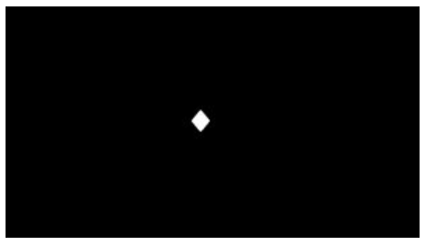

Image subtraction example

Slide 38
Program for subtraction of two images (google colab)
import cv2
from google.colab.patches import cv2_imshow
# Load images
image1 = cv2.imread('/content/input1.jpg')
image2 = cv2.imread('/content/input2.jpg')
# Resize second image to match the first if needed
if image1.shape != image2.shape:
image2 = cv2.resize(image2, (image1.shape[1], image1.shape[0]))
# Subtract image2 from image1
subtracted = cv2.subtract(image1, image2)
# Show result in Google Colab
cv2_imshow(subtracted)

Slide 39
Geometric operations
Geometric operations in image processing involve transforming the spatial relationship between pixels in an image.
These operations are used to change the position, orientation, or scale of images.
They are fundamental for tasks such as image registration, alignment, and enhancement.

Slide 40
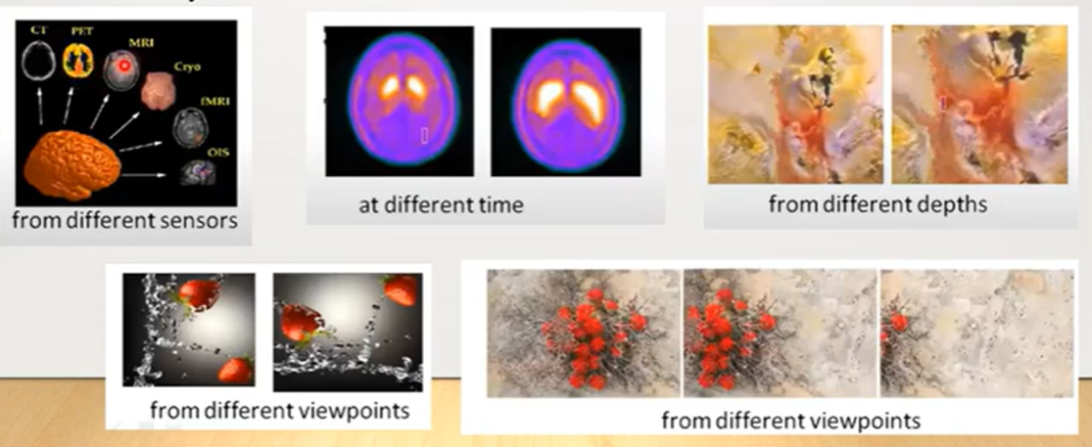
Importance of geometric operations in image registration
Image registration is the process of aligning two or more images of the same scene taken at different times, from different viewpoints, or by different sensors.
Geometric operations are essential in this process because they enable the transformation and alignment of images to a common coordinate system.

Slide 41
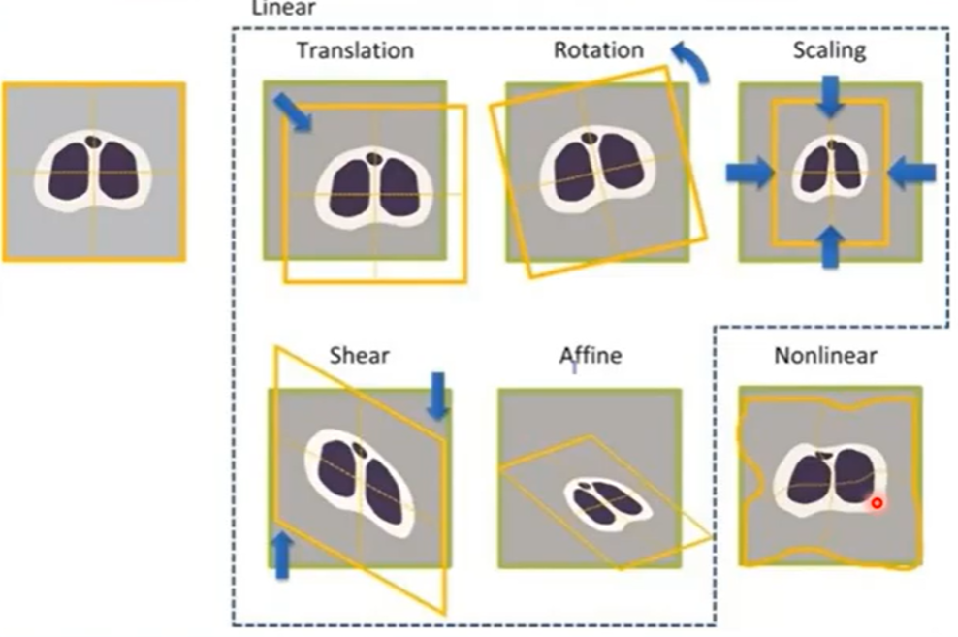
Types of geometric operations

Slide 42
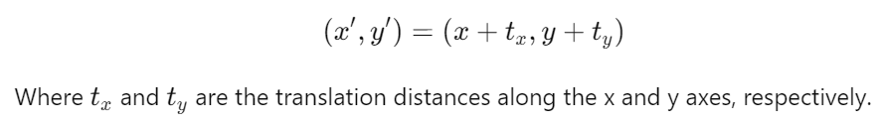
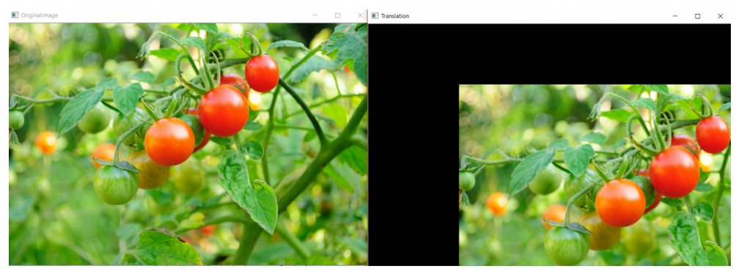
Translation
Shifting an image by a certain amount in the x and y directions.
Used to move objects within an image or to align images in sequence.
Formula :

Slide 43
Program for translation of an image (google colab)
import cv2
import numpy as np
from google.colab.patches import cv2_imshow
# Load image
img = cv2.imread('/content/image1.jpg')
h, w = img.shape[:2]
# Translation values (pixels), tx → Shift in x-direction (horizontal). Positive → right, Negative → left; ty → Shift in y-direction (vertical). Positive → down, Negative → up
tx, ty = 100, 50 # right and down
# 2×3 affine transformation matrix moves (translates) the image
M = np.float32([[1, 0, tx],
[0, 1, ty]])
# Apply translation (same output size as original) using warpAffine
translated = cv2.warpAffine(img, M, (w, h))
# Show original and translated images
cv2_imshow(img)
cv2_imshow(translated)

Slide 44
Applications of translation
Hiding a part of the image
Cropping an image
Shifting an image
Animating an image using image translations in loop

Slide 45
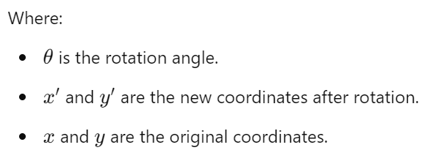
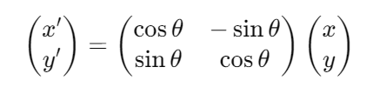
Rotation
Involves turning the image around a specific point, typically its center, by a certain angle.
During this process, the pixel positions are recalculated based on the rotation angle, which can be either clockwise or counterclockwise.
Mathematically, the rotation of an image is achieved using a rotation matrix that adjusts the coordinates of each pixel in the image.

Slide 46


Examples of rotation

Slide 47
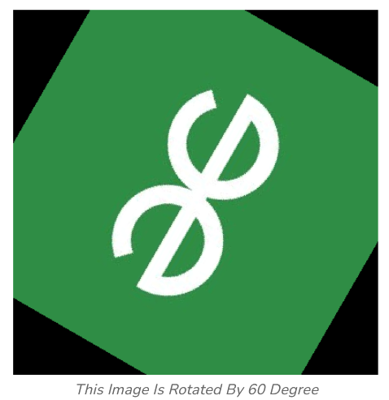
Examples of rotation (cont.)

Slide 48
Program for rotation of an image by 60 degree (google colab)
import cv2
import numpy as np
from google.colab.patches import cv2_imshow
# Load image
img = cv2.imread('/content/input_rot.png')
h, w = img.shape[:2]
# Rotation center (image center)
center = (w // 2, h // 2)
# Get rotation matrix: rotate 60 degrees, scale 1.0
M = cv2.getRotationMatrix2D(center, 60, 1.0)
# Apply rotation (output size same as original)
rotated = cv2.warpAffine(img, M, (w, h))
# Show original and rotated images
cv2_imshow(img)
cv2_imshow(rotated)

Slide 49

Examples of rotation (cont.)

Slide 50
Applications of rotation
Image Alignment and Registration:
Purpose: Aligning images taken from different angles or perspectives. Rotation is used to adjust one image to match the orientation of another for comparison or combination.
Application: Medical imaging (aligning MRI or CT scans), satellite imagery (aligning images from different times), and photo stitching (creating panoramas).
Object Detection and Recognition:
Purpose: Rotating images or features to standard orientations to facilitate the detection and recognition of objects regardless of their orientation.
Application: Face recognition systems (where faces may appear at various angles), automatic number plate recognition, and detecting vehicles or objects in aerial imagery.

Slide 51
Applications of rotation (cont.)
Augmented Reality (AR):
Purpose: Overlaying virtual objects onto real-world scenes requires rotating the virtual objects to match the orientation of the real-world surfaces.
Application: AR applications like virtual furniture placement, heads-up displays in vehicles, and interactive gaming.
Image Augmentation in Machine Learning:
Purpose: Rotating images is a common technique in data augmentation to increase the diversity of the training dataset, helping models generalize better.
Application: Training convolutional neural networks (CNNs) for tasks like image classification, object detection, and semantic segmentation.

Slide 52
Applications of rotation (cont.)
Artistic Effects:
Purpose: Applying rotation to create visually appealing or artistic effects in image editing.
Application: Graphic design, photography post-processing, and digital art creation.
Correction of Image Orientation:
Purpose: Correcting the orientation of images that were captured at an incorrect angle.
Application: Rotating scanned documents, correcting photos taken at an angle, and aligning text in document processing.

Slide 53
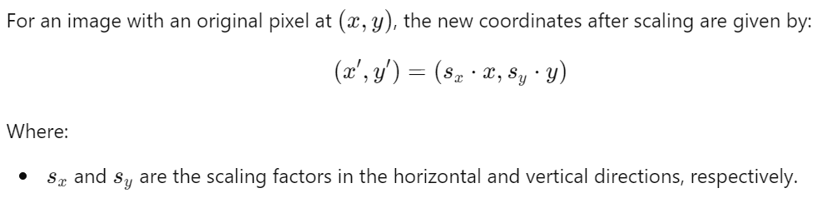
Scaling
Scaling in image processing refers to the process of resizing an image by changing its dimensions, either enlarging or shrinking the image.
Scaling down deals with making image smaller while Scaling up refers to increase the size of image.
Scaling an image involves adjusting the coordinates of the pixels in the image according to a scaling factor.
Scaling Factor s:
If s>1, the image is enlarged (upscaling).
If s<1, the image is reduced in size (downscaling).

Slide 54
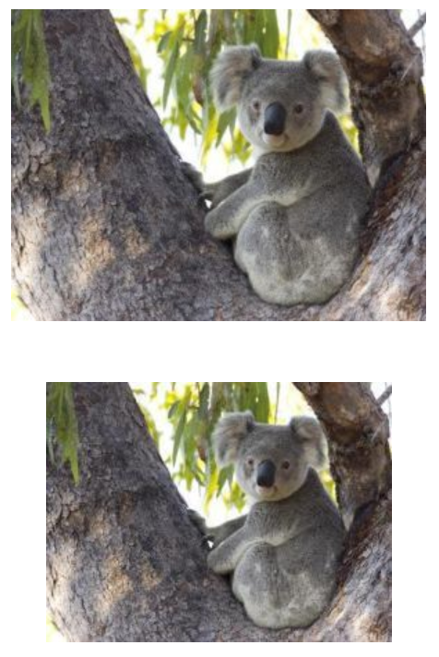
Examples of scaling

Slide 55
Applications of scaling
Image Resizing:
Purpose: To fit images into different display resolutions or to prepare them for printing.
Application: Web development (resizing images to fit various screen sizes) and preparing images for different formats.
Zooming:
Purpose: To magnify a specific part of an image for detailed analysis.
Application: Medical imaging (zooming into X-rays or scans), and digital photography (zooming into specific areas of a photo).

Slide 56
Applications of scaling (cont.)
Thumbnail Generation:
Purpose: To create small preview images that represent larger images.
Application: Used in photo galleries, file explorers, and video previews.
Image Compression:
Purpose: To reduce the size of images for storage or transmission.
Application: Used in reducing the size of images in web pages to decrease load times and save bandwidth.

Slide 57
Shearing
Shearing an image means shifting the pixel values either horizontally or vertically.
This process makes the image appear slanted or skewed.
Unlike rotation, which changes the orientation of the image, or scaling, which changes the size, shearing distorts the shape of the image by sliding its rows or columns.
The transformation matrix for shearing depends on whether the shearing is horizontal or vertical.

Slide 58
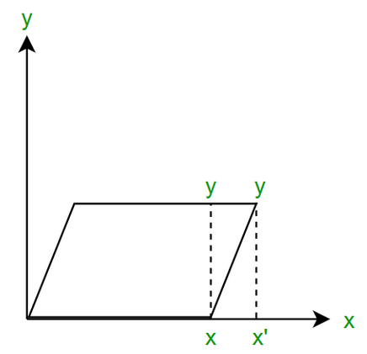
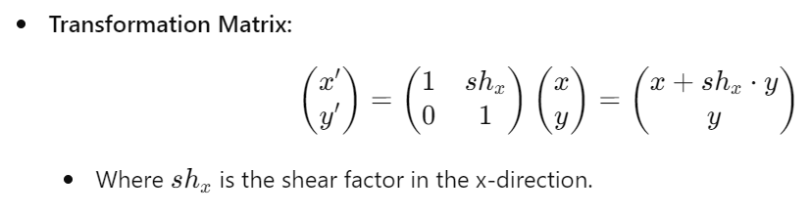
Horizontal Shearing
In horizontal shearing, the x-coordinate of each pixel is shifted by an amount proportional to its y-coordinate.
The image is slanted horizontally, creating a "tilted" effect along the horizontal axis.

Slide 59
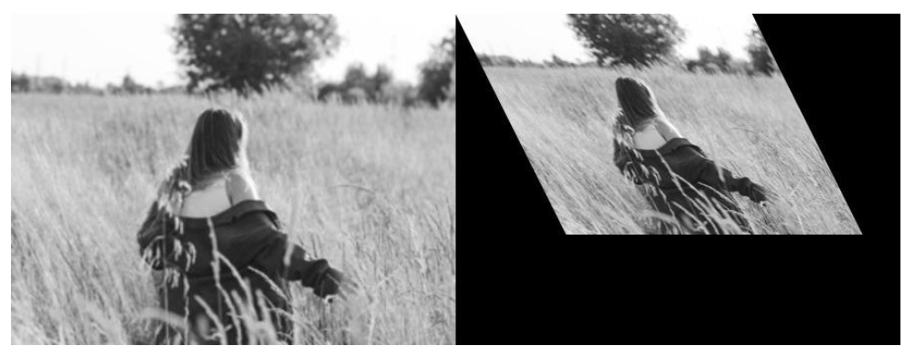
Example of horizontal shearing

Slide 60
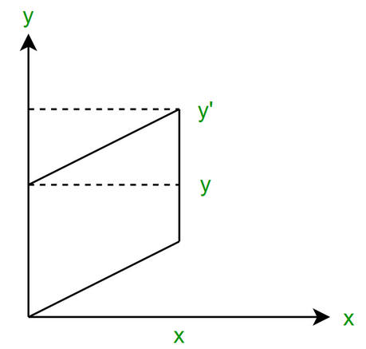
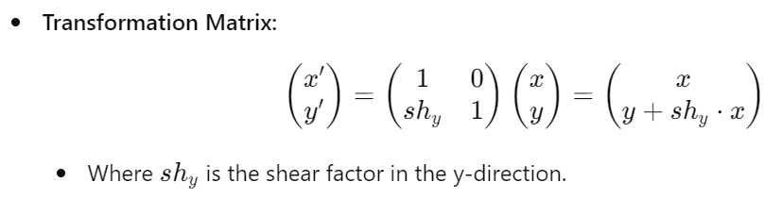
Vertical Shearing
In vertical shearing, the y-coordinate of each pixel is shifted by an amount proportional to its x-coordinate.
The image is slanted vertically, creating a "tilted" effect along the vertical axis.

Slide 61
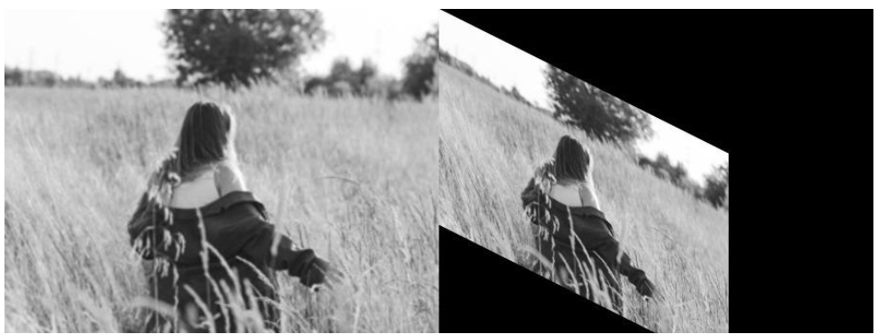
Example of vertical shearing

Slide 62
Applications of shearing
Text Rendering:
Purpose: Shearing can be used to create italicized text in digital fonts by slanting the characters.
Application: Applied in typography and digital typesetting.
Motion Simulation:
Purpose: In animation and video games, shearing can simulate motion or the effect of speed, giving the illusion of a 3D effect.
Application: Used in simulations and animations where objects need to appear as if they are moving at an angle.

Slide 63
Convolution Operations
In mathematics, convolution is an operation performed on two functions (f and g) to produce a third function.
A fundamental mathematical technique used in image processing to apply filters to images, allowing for tasks such as edge detection, blurring, sharpening, and feature extraction.
Convolution involves sliding a filter (also called a kernel or mask) over an image and combining the values from the filter with the pixel values of the image to produce a new image.

Slide 64
How convolution works?
Kernel (Filter):
A kernel is a small matrix (often 3x3, 5x5, etc.) that defines the operation to be applied to the image.
Each element of the kernel represents a weight, and these weights are applied to the corresponding pixels in the image.
Sliding the Kernel:
The kernel is slid over the image, from top-left to bottom-right, one pixel at a time.
At each position, the kernel's values are multiplied by the corresponding pixel values in the image, and the results are summed to produce a single output value.
Generating the Output:
The output of the convolution operation is a new image where each pixel represents the result of applying the kernel to the corresponding area in the original image.

Slide 65
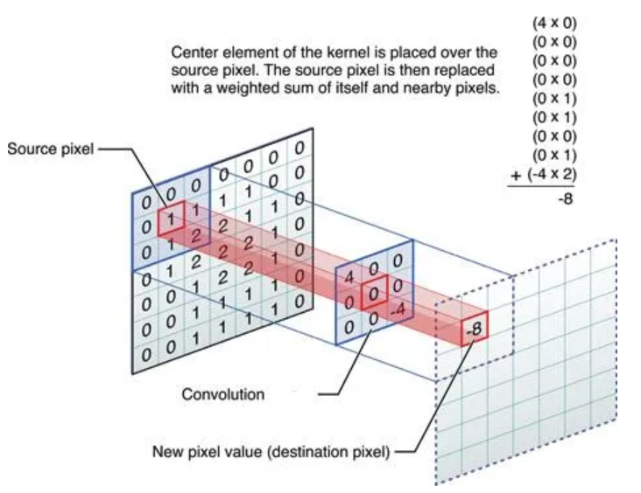
Convolution Operation on 7x7 matrix with a 3x3 kernel

Slide 66
Convolution Operation on 7x7 matrix with a 3x3 kernel
In this example, at the first position, we have 0 in source pixel and 4 in the kernel. 4x0 is 0, then moving to the next pixel we have 0 and 0 in both places. 0x0 is 0.
Then again 0x0 is 0. Next at the center there is 1 in the source image and 0 in the corresponding position of kernel. 0x1 is 0. Then again 0x1 is 0.
Then 0x0 is 0 and 0x1 is 0 and at the last position it is -4x2 which is -8. Now summing up all these results we get -8 as the answer so the output of this convolution operation is -8. This result is updated in the Destination image.

Slide 67
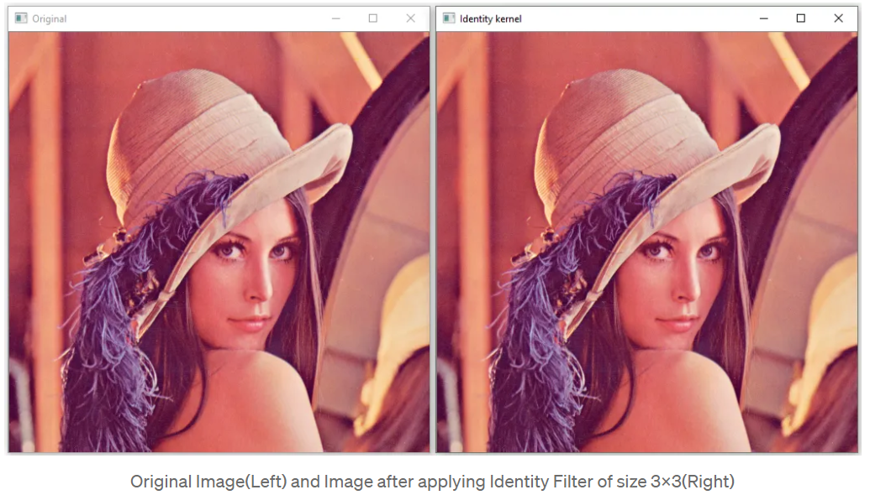
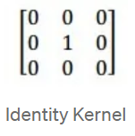
Application of identity kernel on image
An Identity Kernel , when applied to an image through convolution, will have no effect on the resulting image.
Every pixel will retain its original value as shown in the following figure.

Slide 68
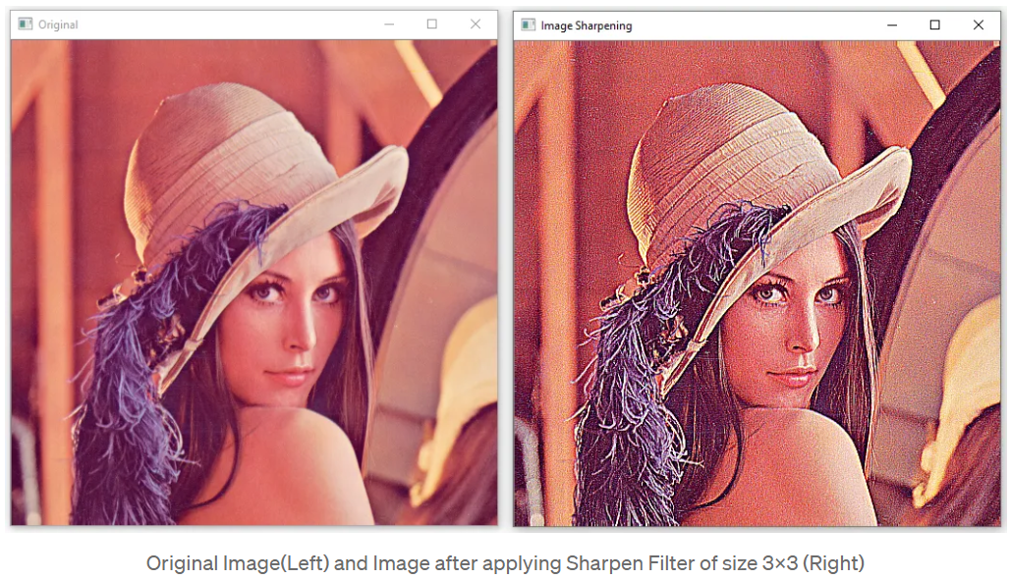
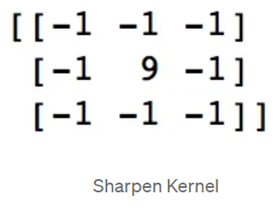
Application of sharpen kernel on image
A Sharpen Kernel when applied to an image through convolution, will have an image sharpening effect to the resulting image.

Slide 69
Convolution in CNN
A CNN comprises of Convolutional Layer, Pooling Layer, and Fully-Connected Layer.
At the Convolution layer, a CNN applies convolution on to its inputs using a Kernel Matrix that it calibrates through training.
For this reason, CNNs are very good at feature matching in images and object classification.

Slide 70
Applications of Convolution
Edge Detection:
Sobel Operator: Uses convolution to detect edges by highlighting areas of high gradient in intensity.
Example: Applying the Sobel operator to detect horizontal or vertical edges in an image.
Blurring:
Gaussian Blur: A Gaussian kernel is used to apply a blurring effect, which smooths out noise and detail.
Example: Reducing noise in an image by convolving it with a Gaussian kernel.
Sharpening:
Laplacian Operator: Enhances edges by highlighting areas where the intensity changes rapidly.
Example: Enhancing the details of an image by convolving it with a Laplacian kernel.
Feature Extraction:
Gabor Filters: Used in texture analysis and feature extraction, especially in applications like fingerprint recognition.
Example: Extracting texture features from an image by applying Gabor filters.

